Slide 1
Course Details
Course Code : CSE3003
Course Name: Mobile Application Development [MAD] Credit Structure: 3 Credits (L=1, P=4, C=3)
Instructor In-Charge: Sunil Sahoo

Slide 2
Module 1
Introduction and Architecture of Android

Slide 3
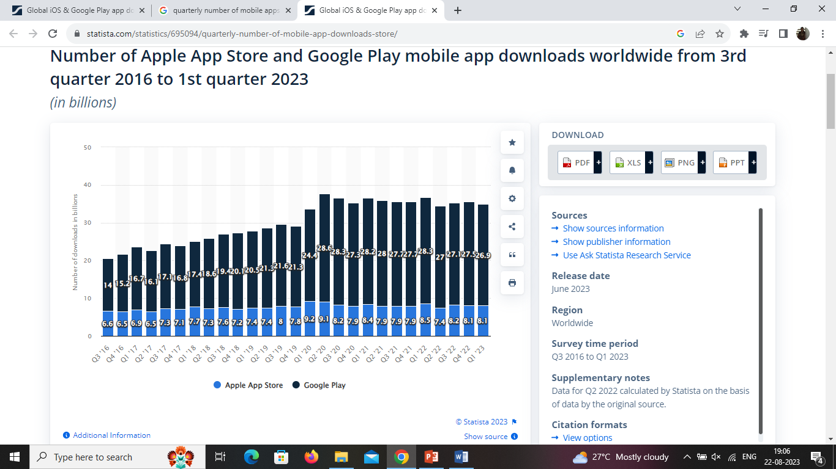
Number of Apple App Store and Google Play mobile app downloads worldwide from 3rd quarter 2016 to 1st quarter 2023. (ref: https://www.statista.com/statistics/695094/quarterly-number-of-mobile-app-downloads-store/)
Why You Should Learn ?
Android key statistics:(ref: https://www.businessofapps.com/data/android-statistics/)
Android has over three billion active users
Three quarters of all smartphones in the world run Android
Over 1.5 billion Android smartphones were shipped last year
Samsung is the largest Android smartphone manufacturer, followed by Xiaomi and Oppo

Slide 4
Today's Trends in MAD
Internet of Things (IoT) App Integration
Apps For Foldable Devices
5G Technology
Development For Wearable Devices
Mobile Commerce
Artificial Intelligence (AI)
Mobile Wallets
Augmented reality (aka virtual reality) AR / VR Will Become More Impressive
Predictive Analytics
Superior App Security
Chatbots

Slide 5
Challenges of Android app development
Building for a multi-screen world
Getting performance right
Keeping your code and your users secure
Remaining compatible with older platform versions
Understanding the market and the user.
Notes:
The Android Developers of today and tomorrow will be responsible for integrating exciting technologies like Artificial Intelligence, Augmented Reality/Virtual Reality, and IoT onto existing applications on the Android OS, creating the new apps for tomorrow that people will use to access information and transact.
Further, as smartphones evolve from entertainment devices to the primary gateway of commercial exchange, creating financial services on mobile platforms is an epoch-changing work in progress with great potential for the years to come.
Finally, as smartphones become the holders of massive reams of personal data, Android developers of the immediate future will have to design security systems to prevent the loss of personal data for millions. The possibilities and potential are truly endless.

Slide 6
Demand for mobile developers:
In India alone, a perusal of job searching platforms like Naukri, Indeed, LinkedIn and Angel List reveal that there are over 20,000 open Android Developer jobs today. Companies are moving more heavily into creating a consummate app experience, driven by projections of smartphone penetration globally.
Nearly all consumer-facing industries have indelibly changed as the smartphone-wielding consumer has become their mainstream target audience.

Slide 7
on-demand industry:
Laundry service
Doctors on-demand
Virtual tutors and coaches
Food delivery
House cleaning
Maintenance services
Fitness on-demand
Pet care
Barber and beauty salon

Slide 8
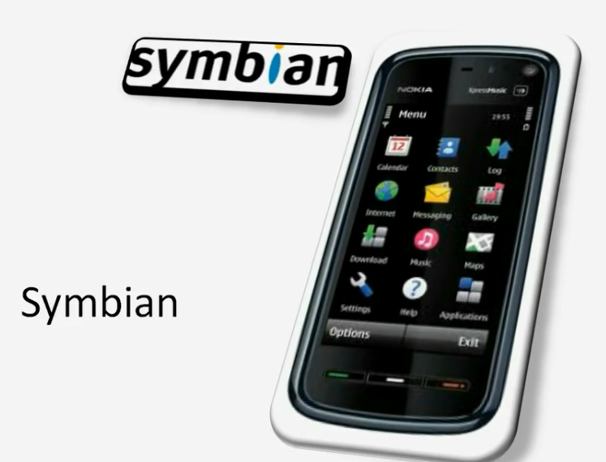
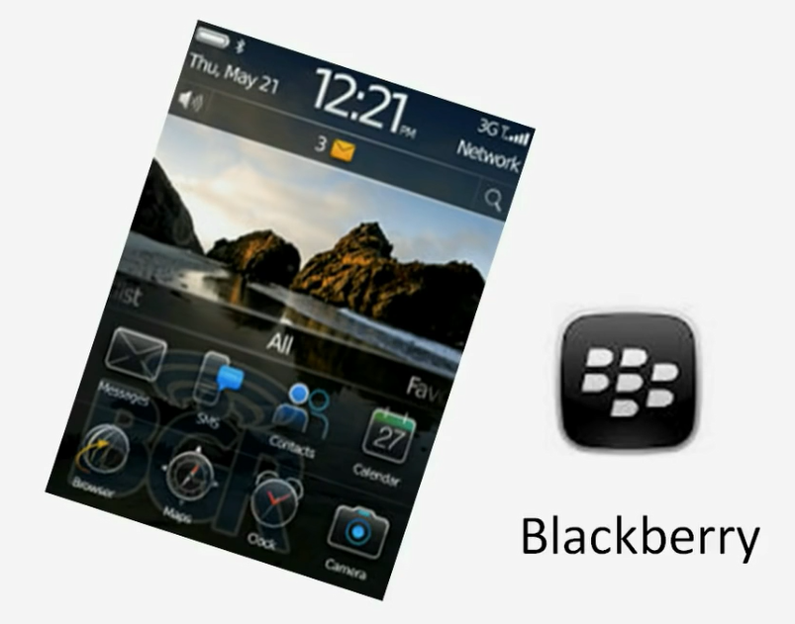
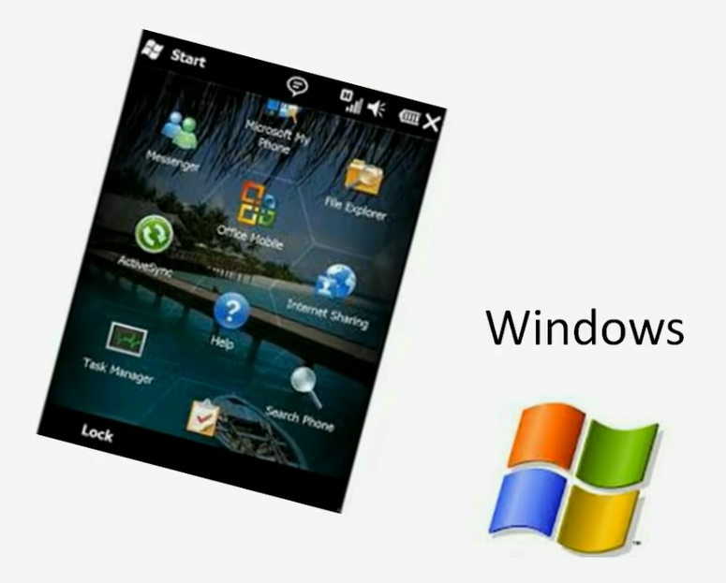
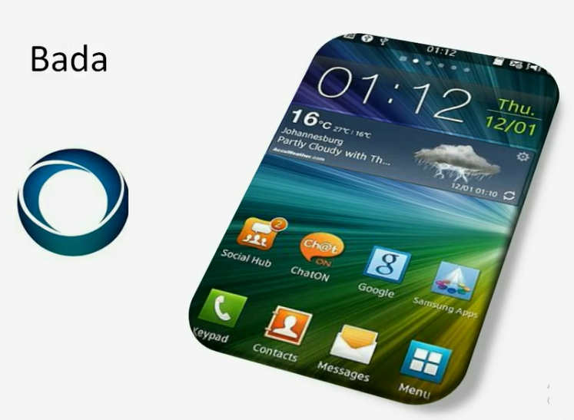
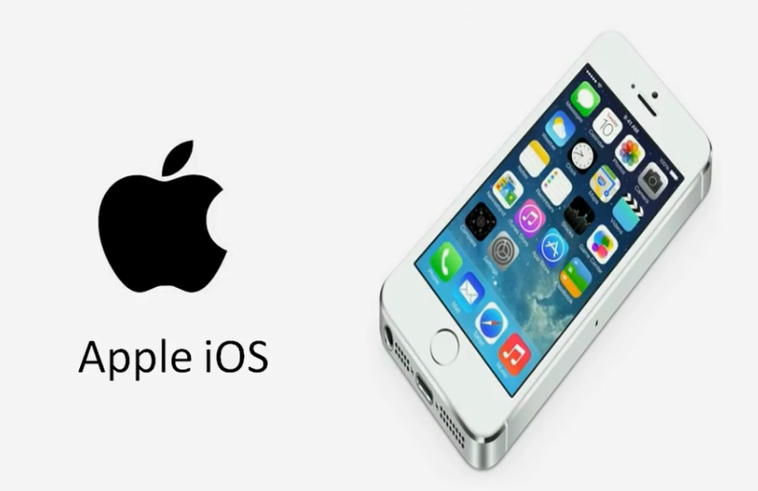
History of Mobile OS
Blackberry – 1999 – RIM(Research in Mortion)
Nokia ( C & C++)
MS
Apple IOS
Samsung

Slide 9
Android: History
Mobile phone are very common today among people of various age groups.
There are many OS to power the mobile phones, we will focus on Android.
Android is based on Linux family of OSs and written in C,C++ and Java Programming language.
Java lies on the top of its all development layers and therefore its applications are written in Java.
To develop an Android application , Android Software Development Kit (Android SDK) is available with all essential tools (Complier, debugger, device emulator and VM to run Android programs).
Emulator is a virtual device that is used to test or run the application without the availability of hardware.

Slide 10

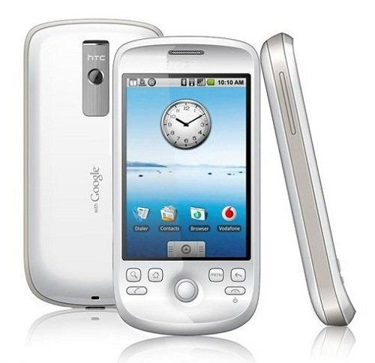
Android: History
Andy Rubin founded Android Incorporation in Palo Alto, California, United States in October, 2003.
In 17th August 2005, Google acquired android Incorporation. Since then, it is in the subsidiary of Google Incorporation.
The key employees of Android Incorporation are Andy Rubin, Rich Miner, Chris White and Nick Sears.
Originally intended for camera but shifted to smart phones later because of low market for camera only.
In 2007, Google announces the development of android OS.
In 2008, HTC launched the first android mobile.
Andy Rubin
HTC Dream

Slide 11
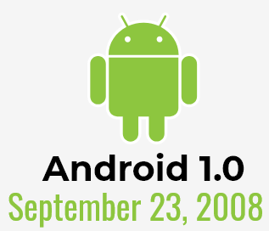
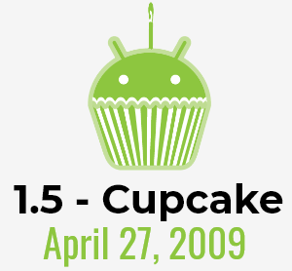

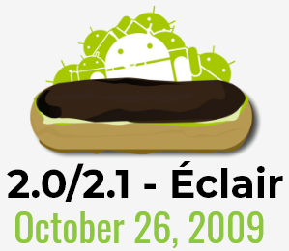

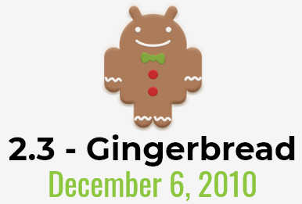


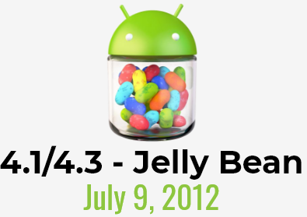

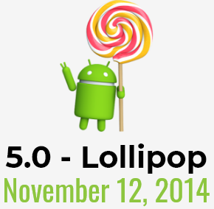

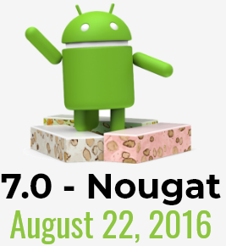


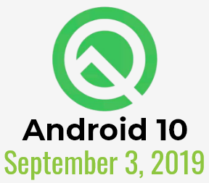
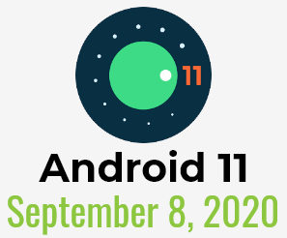
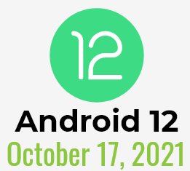


Android: Versions
The code names of android ranges from A to V and Android 15 is currently on progress
Android 13
August 15,2022
Android 14
Q3, 2024
Image Ref: https://www.cellphonedeal.com/blog/the-evolution-of-android

Slide 12
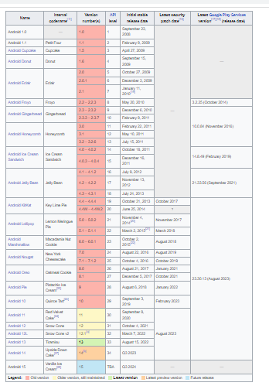
Android: Versions
Ref: https://en.wikipedia.org/wiki/Android_version_history

Slide 13
Android: Open Handset Alliance[OHA]
Group of companies, who have come together to accelerate innovation in mobile.
Offer consumers a richer, less expensive, and better mobile experience.
Android™ - the first complete, open, and free mobile platform.
Building a better phone for consumers: Building a better mobile phone would enrich the lives of countless people across the globe.
Innovating in the open: Increased openness will enable everyone in our industry to innovate more rapidly and respond better to consumers’ demands.
Making the vision a reality: commercially deploy handsets and services using the Android Platform.
Members
Mobile Operators
Handset Manufacturers
Semiconductor Companies
Software Companies
Commercialization Companies
Ref: https://www.openhandsetalliance.com/oha_members.html

Slide 14
Android: Features
Storage — Uses SQLite, a lightweight relational database, for data storage.
Connectivity — Supports GSM/EDGE, IDEN, CDMA, EV-DO, UMTS, Bluetooth (includes A2DP and AVRCP), Wi-Fi, LTE, and WiMAX.
Messaging — Supports both SMS and MMS.
Web browser — Based on the open source WebKit, together with Chrome’s V8 JavaScript engine
Media support — Includes support for the following media: H.263, H.264 (in 3GP or MP4 container), MPEG-4 SP, AMR, AMR-WB (in 3GP container), AAC, HE-AAC (in MP4 or 3GP container), MP3, MIDI, Ogg Vorbis, WAV, JPEG, PNG, GIF, and BMP.

Slide 15
Android: Features
Hardware support — Accelerometer Sensor, Camera, Digital Compass, Proximity Sensor, and GPS
Multi-touch — Supports multi-touch screens
Multi-tasking — Supports multi-tasking applications
Flash support — Android 2.3 supports Flash 10.1.
Tethering — Supports sharing of Internet connections as a wired/wireless hotspot

Slide 16
Android: Development Tools
Top Hybrid Mobile App Frameworks
Mobile Angular UI
Appcelerator Titanium
Kendo UI
Sencha Touch
IONIC
PhoneGap (distribution of Apache Cordova)
Apache Cordova (formerly PhoneGap)
Flutter (early-stage funding from Y Combinator & was acquired by Google in October 2013)

Slide 17
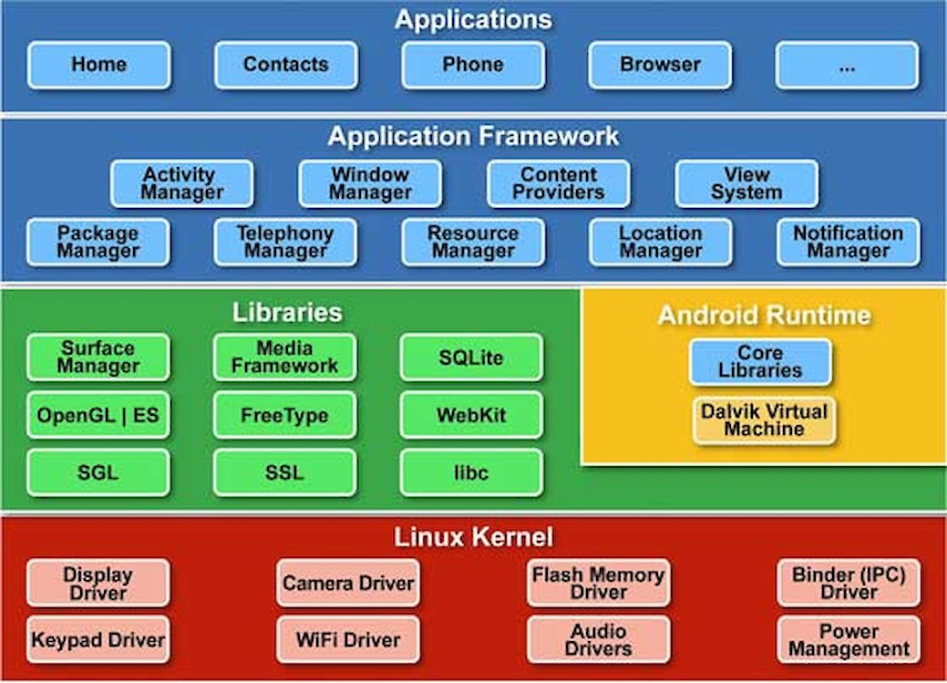
Android: Architecture
1. Linux kernel
It is the heart of android architecture that exists at the root of android architecture.
All the hardware drivers are handled by this kernel.
Drivers are the small programs written specifically to communicate with hardware.
It also serves as the abstraction layer for other layers.
Ref: https://source.android.com/docs/core/architecture/kernel

Slide 18
3. Android Runtime
2. Native Libraries
This layer provides the device, which has the capability to handle different types of data and information.
Code in C and C++ languages for fast procedural transactions of data.
Surface Manager, Media Frame work, WebKit, OpenGL, FreeType, SQLite, Media, C runtime library (libc) etc.
Dalvik Virtual Machine (DVM) which is responsible to run android application.
DVM is like JVM but it is optimized for mobile devices.
It consumes less memory and provides fast performance.
It executes the files with the .dex extension (generated implicitly from the .class file)

Slide 19
5. Application
4. Android Framework
The important blocks of Application framework are UI (User Interface), telephony, resources, locations, Content Providers (data) and package managers.
It provides a lot of classes and interfaces for android application development.
It is the top layer in the Android Architecture.
This is the palace where your application is finally deployed over a device.
All applications such as home, contact, settings, games, browsers are using android framework that uses android runtime and libraries.
Android runtime and native libraries are using Linux kernel.
Pre – installed applications can be replaced by newly written applications.
Makes Oss so flexible.

Slide 20
1. Activity
Application Components
Activity is a single screen with a user interface
Service performs long-running tasks in background
Broadcast receiver responds to system-wide announcements
Content provider manages shared set of data
An Activity object is similar to a WindowsForm. It usually presents a single graphical visual interface (GUI) which in addition to the displaying/collecting of data, provides some kind of ‘code-behind‘ functionality.
A typical Android application contains one or more Activity objects.

Slide 21
1. Activity
Applications must designate one activity as their main task or entry point. That activty is the first to be executed when the app is launched.
An activity may transfer control and data to another activity through an interprocess communication protocol called intents.
For example, a login activity may show a screen to enter user name and password. After clicking a button some authentication process is applied on the data, and before the login activity ends some other activity is called.
2. Services
Services are a special type of activity that do not have a visual user interface. A service object may be active without the user noticing its presence.

Slide 22
2. Services
Services are analogous to secondary threads, usually running some kind of background ‘busy-work‘ for an indefinite period of time.
Applications start their own services or connect to services already active.
Examples:
Your background GPS service could be set to quietly run in the backgroud detecting location information from satellites, phone towers or wi-fi routers. The service could periodically broadcast location coordinates to any app listening for that kind of data. An application may opt for binding to the running GPS service and use the data that it supplies.

Slide 23
3. Broadcast Receiver
A BroadcastReceiver is a dedicated listener that waits for a triggering system-wide message to do some work. The message could be something like: low-battery, wi-fi connection available, earth-quakes in California, speed-camera nearby.
Broadcast receivers do not display a user interface.
They tipically register with the system by means of a filter acting as a key. When the broadcasted message matches the key the receiver is activated.
A broadcast receiver could respond by either executing a specific activity or use the notification mechanism to request the user‘s attention.

Slide 24
4. Content Provider
A content provider is a data-centric service that makes persistent datasets available to any number of applications.
Common global datasets include: contacts, pictures, messages, audio files, emails.
The global datasets are usually stored in a SQLite database (however the developer does not need to be an SQL expert)
The content provider class offers a standard set of parametric methods to enable other applications to retrieve, delete, update, and insert data items.

Slide 25
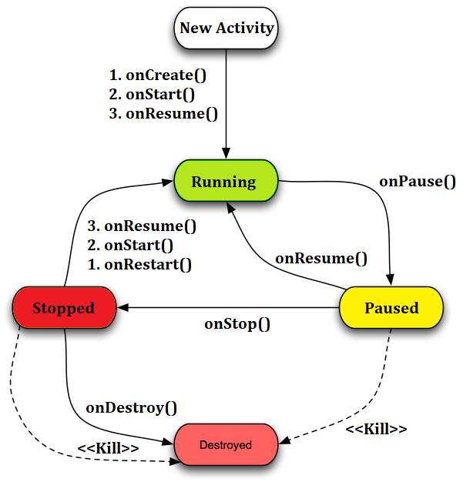
Android: Activity Life cycle
Image Ref: https://www.androhub.com/android-activity-lifecycle/
Notes:
Video Ref: https://www.youtube.com/watch?v=UJN3AL4tiqw

Slide 26
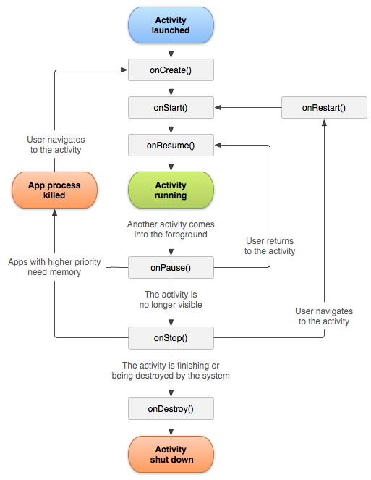
Android Activity Lifecycle methods
Method | Description
onCreate | called when activity is first created.
onStart | called when activity is becoming visible to the user.
onResume | called when activity will start interacting with the user.
onPause | called when activity does not receive user input and cannot execute any code and called when the current activity is being paused and the previous activity is being resumed.
onStop | called when activity is no longer visible to the user.
onRestart | called after your activity is stopped, prior to start.
onDestroy | called before the activity is destroyed by the system.
Image Ref:
https://www.androhub.com/android-activity-lifecycle/
https://developer.android.com/guide/components/activities/activity-lifecycle

Slide 27
SDK (software development kit) Manager
The first and most important piece of software you need to download is, of course, the Android
SDK. The Android SDK contains a debugger, libraries, an emulator, documentation, sample code and tutorials.
You can download the Android SDK from http://developer.android.com/sdk/index.html
Android Debug Bridge (ADB)
ADB is a versatile command-line tool that lets you communicate with a device.
The ADB command facilitates a variety of device actions, such as installing and debugging apps, and it provides access to a Unix shell that you can use to run a variety of commands on a device.

Slide 28
Android Debug Bridge (ADB)
It is a client-server program that includes three components:
A client, which sends commands. The client runs on your development machine. You can invoke a client from a command-line terminal by issuing an ADB command.
A daemon (ADBD), which runs commands on a device. The daemon runs as a background process on each device.
A server, which manages communication between the client and the daemon. The server runs as a background process on your development machine.

Slide 29
Lifecycle
MainActivity is the main or parent thread over which other activity / child thread will be created
Every Activity gets created with onCreate() method
Starts with onStart() and dies with onDestroy()
If many child activity gets created, then the running thread moves to pause state with onPause()
When second activity stoped/completd/paused with onPause()/onStop()again first activity moves to running state with onResume()
We can restart an activity for memory clean by invoking onRestart()

Slide 30
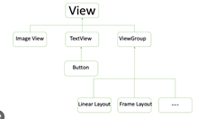
View class
View is base class of all UI elements
The classes those are not under ViewGroup are called widgets the classes those are under viewGroup are called parents ConstraintLayout sets constraints relative to parents by default
(margin-constraint,height and width
constraint (basic)

Slide 31
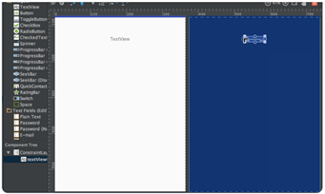
ConstraintLayout
It is used to define a layout by assigning constraints for every child view/widget relative to other views present. A constraintLayout is similar to RelativeLayout , but with more power. The aim of ConstraintLayout is to improve the performance of the applications by removing the nested views with a flat and flexible design.
A view inside the ConstraintLayout has anchor points/handles on each side which are used to assign the constraints.

Slide 32
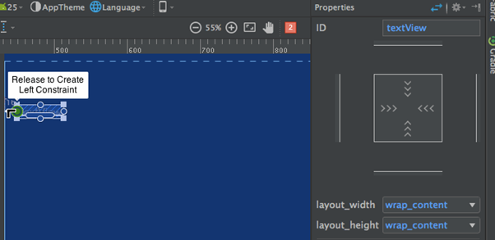
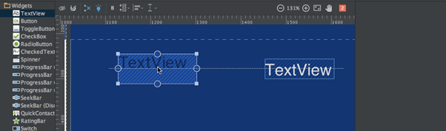
ConstraintLayout
The TextView above has three types of handles:
Resize handle - It’s present on the four corners and is used to resize the view, but keeping its constraints intact.
Side handle - It’s the circular handle present on the centre of each side. It’s used to set the top, left, bottom and right constraints of the view.
Baseline handle - It’s used to align the baseline with another textview in the layout.
Let’s assign the constraints on the TextView and look into the xml code of it.

Slide 33
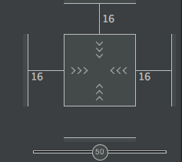



ConstraintLayout
Notice the Properties inspector pane at the right-hand side:
It shows the margins set for each side of the view. It also allows to change the size of the view by toggling between the following modes:
Wrap Content - This wraps the view to fill it’s content.
Any Size - This is similar to match parent.
Fixed Size - This allows us to set constant width and height.

Slide 34
ConstraintLayout
<TextView
android:text="TextView"
android:layout_width="wrap_content"
android:layout_height="wrap_content"
android:id="@+id/textView"
android:layout_marginStart="16dp"
android:layout_marginTop="16dp"
app:layout_constraintLeft_toLeftOf="parent"
app:layout_constraintTop_toTopOf="parent"
android:layout_marginLeft="16dp"
android:layout_marginEnd="16dp"
app:layout_constraintRight_toRightOf="parent"
android:layout_marginRight="16dp" />
</android.support.constraint.ConstraintLayout>
Sample.xml
<?xml version="1.0" encoding="utf-8"?>
<android.support.constraint.ConstraintLayout
xmlns:android="https://schemas.android.com/apk/res/android"
xmlns:app="https://schemas.android.com/apk/res-auto"
android:layout_width="match_parent"
android:layout_height="match_parent">

Slide 35
ConstraintLayout
TextView with another TextView
Baseline allignment

Slide 36
ConstraintLayout
<TextView
android:text="TextView"
android:layout_width="wrap_content"
android:layout_height="wrap_content"
android:id="@+id/textView2" app:layout_constraintBaseline_toBaselineOf="@+id/textView"
android:layout_marginStart="16dp"
app:layout_constraintLeft_toLeftOf="parent"
android:layout_marginLeft="16dp"
app:layout_constraintRight_toLeftOf="@+id/textView"
android:layout_marginEnd="8dp"
android:layout_marginRight="8dp" /> </android.support.constraint.ConstraintLayout>
baseline.xml
<TextView
android:text="TextView"
android:layout_width="wrap_content"
android:layout_height="wrap_content"
android:id="@+id/textView"
android:layout_marginStart="16dp"
app:layout_constraintLeft_toLeftOf="parent"
android:layout_marginLeft="16dp"
android:layout_marginEnd="16dp"
app:layout_constraintRight_toRightOf="parent"
android:layout_marginRight="16dp"
android:layout_marginTop="16dp"
app:layout_constraintTop_toTopOf="parent" />

Slide 37

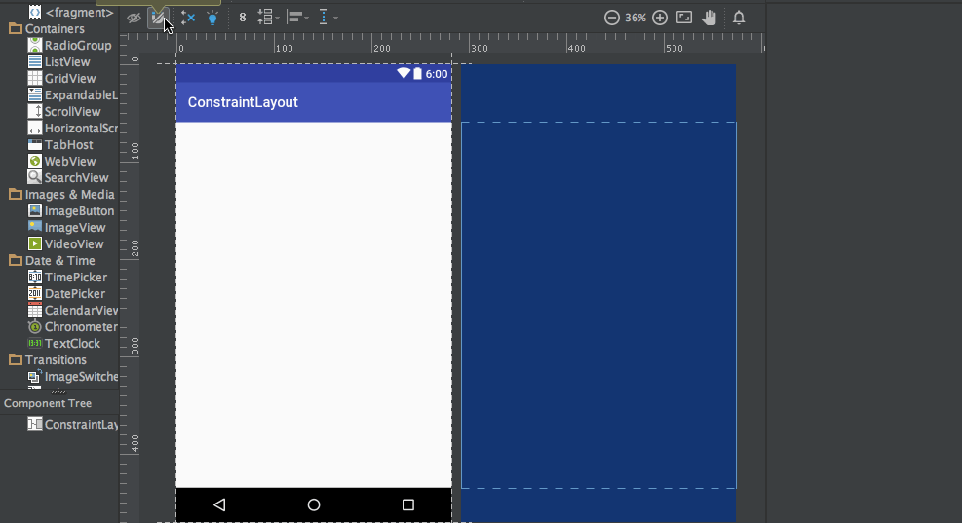
ConstraintLayout
There are two other tools Auto-connect and Inferences that are used to created constraints automatically.
Auto-Connect - This feature can be enabled by clicking :
As the name suggests, Auto-connect creates constraints automatically between two neighbouring views
Inference - This feature is enabled by clicking:
The Inference engine creates constraints among all elements in a layout. The inference engine tries to find and create optimal connections based on various factors such as the positions of the widgets and their size.

Slide 38
ConstraintLayout
<TextView
android:text="TextView"
android:layout_width="wrap_content"
android:layout_height="wrap_content"
android:id="@+id/textView2" app:layout_constraintBaseline_toBaselineOf="@+id/textView"
android:layout_marginStart="16dp"
app:layout_constraintLeft_toLeftOf="parent"
android:layout_marginLeft="16dp"
app:layout_constraintRight_toLeftOf="@+id/textView"
android:layout_marginEnd="8dp"
android:layout_marginRight="8dp" /> </android.support.constraint.ConstraintLayout>
sample.xml
<ImageView
android:layout_width="wrap_content"
android:layout_height="wrap_content"
app:srcCompat="@mipmap/ic_launcher"
android:id="@+id/imageView7"
app:layout_constraintBottom_toBottomOf="parent"
app:layout_constraintRight_toRightOf="parent"
app:layout_constraintLeft_toLeftOf="parent"
app:layout_constraintTop_toTopOf="parent"
app:layout_constraintVertical_bias="0.58000004"
app:layout_constraintHorizontal_bias="0.47" />

Slide 39
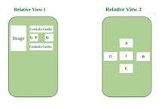
RelativeLayout
RelativeLayout is a layout in which we can arrange views/widgets according to the position of other views/widgets. It is independent of horizontal and vertical view and we can arrange it according to one’s satisfaction.

Slide 40
RelativeLayout
<RelativeLayout
android:layout_width="wrap_content"
android:layout_height="wrap_content">
<!--ImageView, TextView, ButtonView
etc with specified position-->
</RelativeLayout>

Slide 41
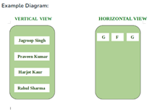
LinearLayout
LinearLayout is a type of view group which is responsible for holding views in it either Horizontally or vertically. It is a type of Layout where one can arrange groups either Horizontally or Vertically.

Slide 42
LinearLayout
<LinearLayout
android:layout_width="wrap_content"
android:layout_height="wrap_content"
android:orientation="either vertical or horizontal">
<!--ImageView, TextView, ButtonView etc.-->
</LinearLayout>

Slide 43
LinearLayout vs RelativeLayout
LinearLayout | RelativeLayout
We can adjust views and widgets linearly i.e Horizontally and vertically. | We can adjust views and widgets according to one’s satisfaction.
layout_weight attribute in the linear layout is used to specify the equal or specific size to the particular widget and view by using the following attribute android:layout_weight = ‘0’ Here Weight is specified as 0 in order to give equal size or space to each view or widget. | Various attributes like: layout_toRightOf, layout_toLeftOf, layout_below, layout_alignParentTop, layout_top, layout_alignParentLeft, layout_alignParentRight are used to specify the position of each view and widget.
It is useful when we arrange views in a linear fashion. | It is useful when we arrange views in relative fashion.
Syntax: <LinearLayout> <!–Views, widgets–> </LinearLayout> | Syntax: <RelativeLayout> <!–Views, Widgets–> </RelativeLayout>
Example: In various Apps, LinearLayout is mainly applicable in the SignUp screen where Name, Email, Phone Number, Submit, etc. are arranged in a linear fashion. | Example: In Google Play Store, when we open the app, the games, books, movies, and App’s sections all are arranges in Relative Layout Fashion.
LinearLayout is less used as compared to RelativeLayout. | RelativeLayout is used more in applications.
We can use LinearLayout inside RelativeLayout. | We can also use RelativeLayout as a Child of LinearLayout.

Slide 44
More Layouts
Android Frame Layout: FrameLayout is a ViewGroup subclass, used to specify the position of View elements it contains on the top of each other to display only a single View inside the FrameLayout.
Android Table Layout: TableLayout is a ViewGroup subclass, used to display the child View elements in rows and columns.
Android Web View: WebView is a browser that is used to display the web pages in our activity layout.
Android ListView: ListView is a ViewGroup, used to display scrollable lists of items in a single column.
Android Grid View: GridView is a ViewGroup that is used to display a scrollable list of items in a grid view of rows and columns.

Slide 45
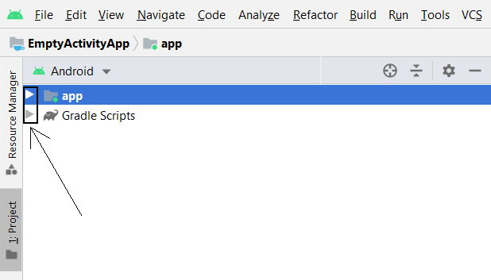
Exploring an Empty Activity project
Note
We do not need to explore the Gradle Scripts folder in the context of this book. Gradle is a significant part of Android Studio, but its role is to hide from the user the quite complicated processes that Android Studio performs— things such as adding resource files, and compiling and building projects.
Therefore, we don't need to dig into this any further. If, however, you decide to take Android to the next level, then getting a good understanding of Gradle and its relationship with Android Studio is time well invested.
Project Explorer Window
The two arrow (above) allow us to expand the app and Gradle Scripts folders

Slide 46
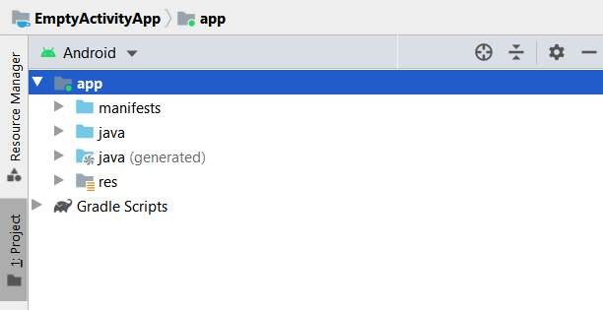
Exploring an Empty Activity project
Explore in detail the app folder. Click the arrow next to the app folder to expand its contents, and we will begin exploring. The first level of contents is shown in the following screenshot:
Note
four more folders: manifests, java, java(generated), and res. Let's look at all four, starting at the top.
Exploring the app folder

Slide 47
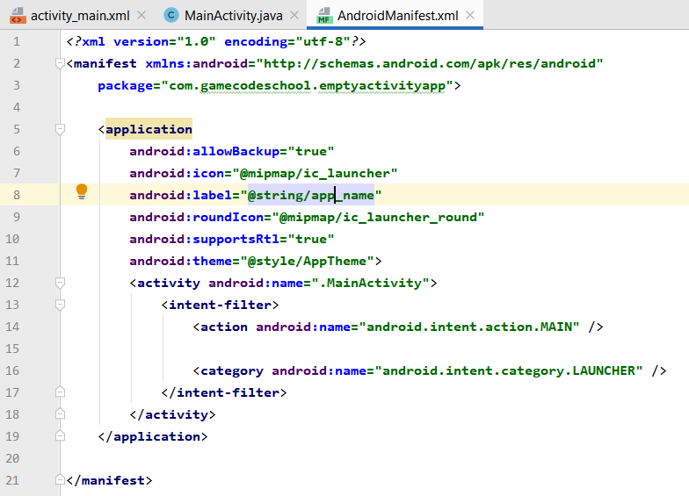
Exploring an Empty Activity project
Note
We don't need to understand everything in this file, but it is worth pointing out that we will make occasional amendments here—for example, when we need to ask the user for permission to access features of their device. We will also edit this file when we want to make a fullscreen app for immersivity, such as the drawing app
The line shown next tells Android that the icon we want to show the user in their app drawer/home screen to launch the app is contained in the mipmap folder and is called ic_launcher
android:icon="@mipmap/ic_launcher"
Exploring the manifests folder -> opening AndroidManifest.xml
The next line has two aspects worth discussing. First, it denotes the name that we gave our app; and second, that name is contained as a String with a label of app_name, as illustrated here:
AndroidManifest.xml file but we don't need to. Let's look at just two more, as they are related to each other. The line shown next indicates the name of our Activity, which Android Studio chose when we created the project. I have highlighted the Activity name here, just to make it stand out:
android:label="@string/app_name"
<activity android:name=".MainActivity">

Slide 48
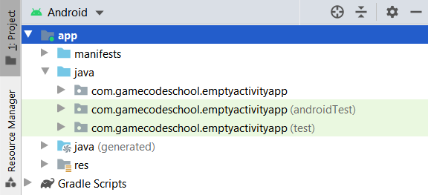
Exploring an Empty Activity project
Note
we will only need one of these three folders—the top one. The names of these folders are composed of the package name (chosen when we created the app) and the app name, in all lowercase and with no spaces (also chosen when we created the app).
Exploring the Java folder
android:label="@string/app_name"

Slide 49
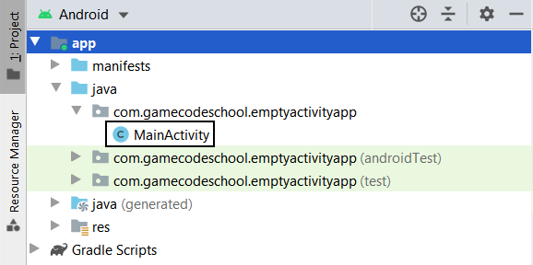
Exploring an Empty Activity project
Note
The only folder we are interested in during the course is the top one, which for this app (on my screen) is com.gamecodeschool.emptyactivityapp.
Depending upon your chosen package name and the name of the app we are currently working on, the folder name will change, but it will always be the top one that we need to access and add—or edit—the contents of.
Expand the com.gamecodeschool.emptyactivityapp (or whatever yours is called) folder now to view its contents. In the next screenshot, you can see that the folder has just one file:
Exploring the Java folder

Slide 50
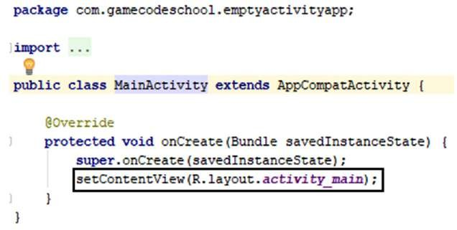
Exploring an Empty Activity project
Note
It has the onCreate method that executes when the app is run by the user, but there is much less code in it and onCreate is the only method. Look at the last line of code in the onCreate method
setContentView(R.layout.activity_main);
Exploring the Java folder

Slide 51
Android Widgets
There are given a lot of android widgets with simplified examples such as Button, EditText, AutoCompleteTextView , ToggleButton, DatePicker, TimePicker, ProgressBar etc.

Slide 52
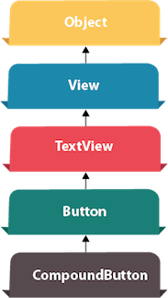
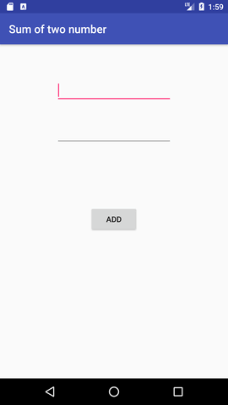
Android Widgets : Android Button
Android Button represents a push-button. The android.widget.Button is subclass of TextView class and CompoundButton is the subclass of Button class.
There are different types of buttons in android such as RadioButton, ToggleButton, CompoundButton etc.
Android Button Example with Listener
button.setOnClickListener(new View.OnClickListener() {
@Override
public void onClick(View view) {
//code
}
});

Slide 53
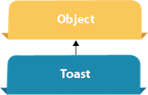
Android Widgets : Android Toast
Displays information for the short duration of time
Toast.makeText(getApplicationContext(),"Hello Javatpoint",Toast.LENGTH_SHORT).show();

Slide 54
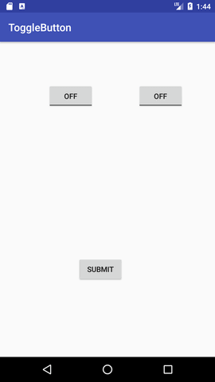
Android Widgets : ToggleButton
It has two states ON/OFF.
buttonSubmit.setOnClickListener(new View.OnClickListener(){
@Override
public void onClick(View view) {
StringBuilder result = new StringBuilder();
result.append("ToggleButton1 : ").append(toggleButton1.getText());
result.append("\nToggleButton2 : ").append(toggleButton2.getText());
//Displaying the message in toast
Toast.makeText(getApplicationContext(), result.toString(),Toast.LENGTH_LONG).show(); }});

Slide 55
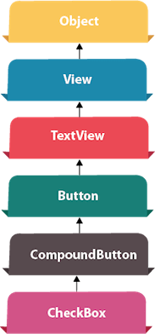
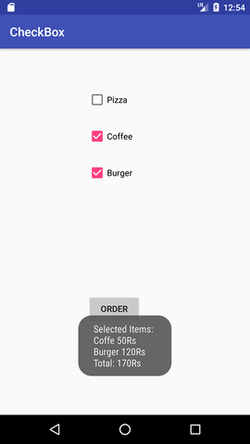
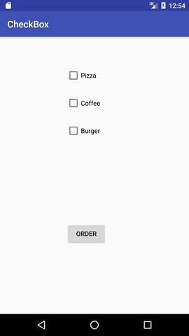
Android Widgets : CheckBox
Android CheckBox is a type of two state button either checked or unchecked.

Slide 56
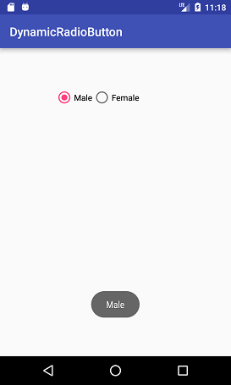
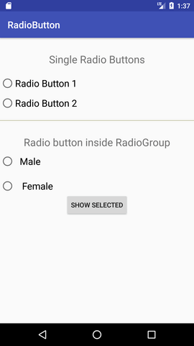
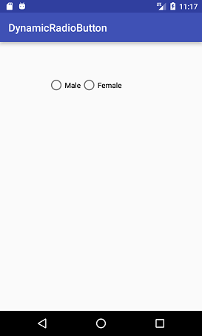
Android Widgets : Android RadioButton
RadioButton is a two states button which is either checked or unchecked. If a single radio button is unchecked, we can click it to make checked radio button. Once a radio button is checked, it cannot be marked as unchecked by user. RadioButton is generally used with RadioGroup. RadioGroup contains several radio buttons, marking one radio button as checked makes all other radio buttons as unchecked.

Slide 57
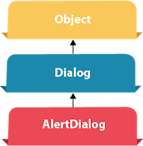
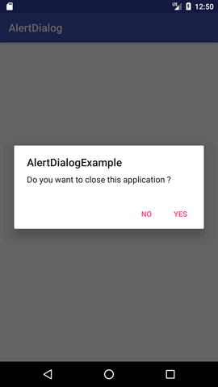
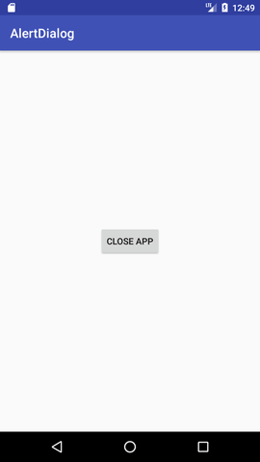
Android Widgets : AlertDialog
AlertDialog displays a alert dialog containing the message with OK and Cancel buttons.

Slide 58
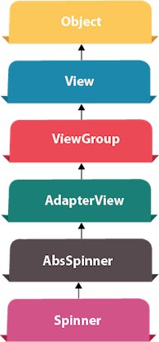
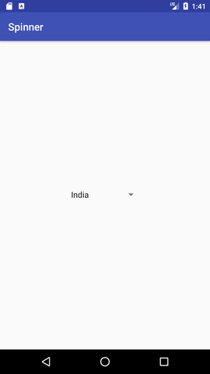

Android Widgets : Spinner
Spinner displays the multiple options, but only one can be selected at a time.

Slide 59



Android Widgets : AutoCompleteTextView
Android AutoCompleteTextView completes the word based on the reserved words, so no need to write all the characters of the word.

Slide 60



Android Widgets : ListView
is a view which contains the group of items and displays in a scrollable list. ListView is implemented by importing android.widget.ListView class. ListView is a default scrollable which does not use other scroll view.

Slide 61



Android Widgets : RatingBar
RatingBar displays the rating bar.

Slide 62


Android Widgets : WebView
Android WebView is used to display web page in android. The web page can be loaded from same application or URL. It is used to display online content in android activity.

Slide 63
Android Widgets : DatePicker
Datepicker displays the datepicker dialog that can be used to pick the date.

Slide 64
Android Widgets : TimePicker
TimePicker displays the timepicker dialog that can be used to pick the time.

Slide 65
Android Widgets : ProgressBar
ProgressBar displays progress task.

Slide 66
Learn more …
Android History
Introduction to Android
Platform Architecture
https://source.android.com/docs/core/architecture
UI Overview
Platform Versions
Supporting Different Platform Versions
Android Studio User’s Guide
Mr. R C Ravindranath, Asst. Prof., SOE-CSE, PU

Slide 67
END OF MODULE 1

Slide 68
Thank You
68
Mr. R C Ravindranath, Asst. Prof., SOE-CSE, PU
Notes:
68

